Slide 1

Command Centre Analysis Report
Data Preparation, Analysis, and Recommendations
Name-Viral upadhyay
Registration Number-21BPS1266
Date-20/1/2025
Case study round AB InBev

Slide 2
Data Preparation:-
Data Preparation is the first and most critical step in our data analysis workflow. It ensures the accuracy, consistency, and integrity of the data, setting the stage for meaningful insights. Without clean and well-structured data, the subsequent analysis may be unreliable or misleading
It is based on how the datasets were cleaned, standardized, and merged to ensure accuracy and consistency.

Slide 3
Addressing Missing Data:-
Missing data means some values in the dataset are blank. For example, if a product's revenue is missing, we cannot calculate its profitability. Ignoring missing data can lead to incorrect analysis or incomplete results.

Slide 4
How Was Implementation done:-
Missing data was checked for all columns .
For Example:
Revenue was blank for some rows.
Customer_Rating was missing for certain products.
Fixed missing values by:
Replacing blank numbers like Revenue or Cost_of_Goods_Sold with 0.
Assigning "No Rating" to missing customer ratings.
Using "Unknown" for blank text columns like Country, Zone, or Product_Category.
How Does the Data Look Now?
All missing values were filled to ensure every row is complete and usable.
This makes the dataset ready for analysis without losing any information.

Slide 5
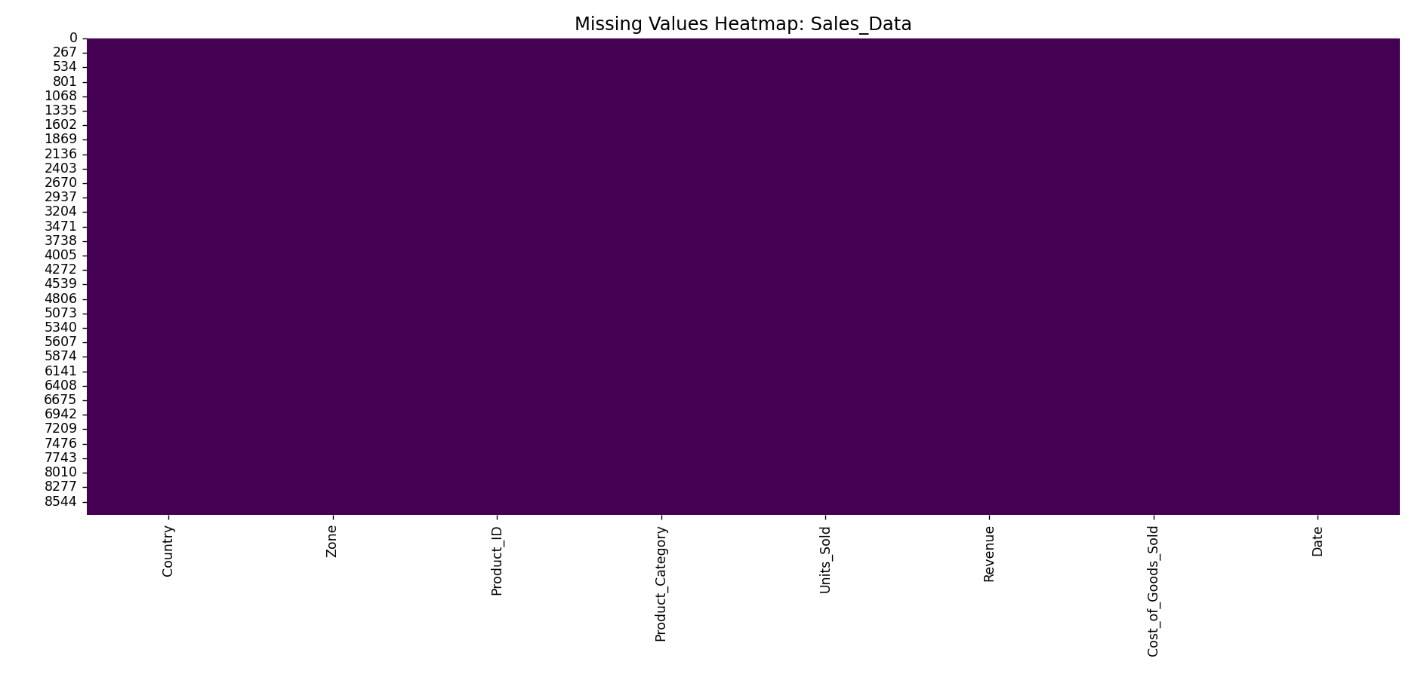

Slide 6
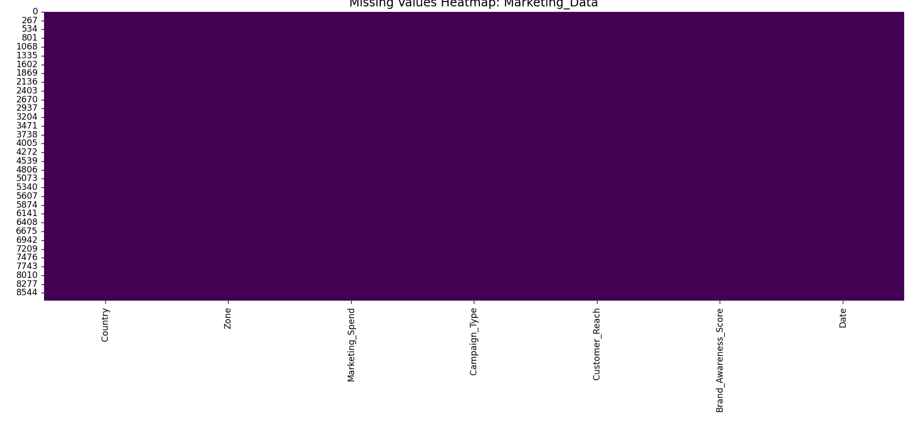
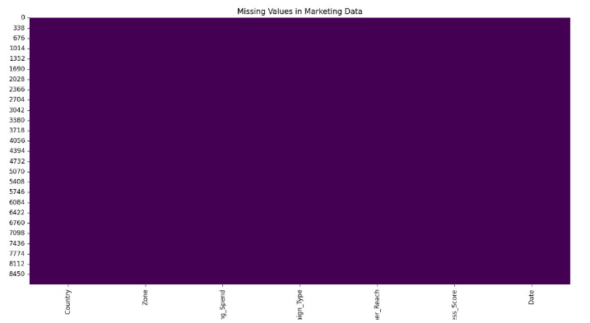

Slide 7
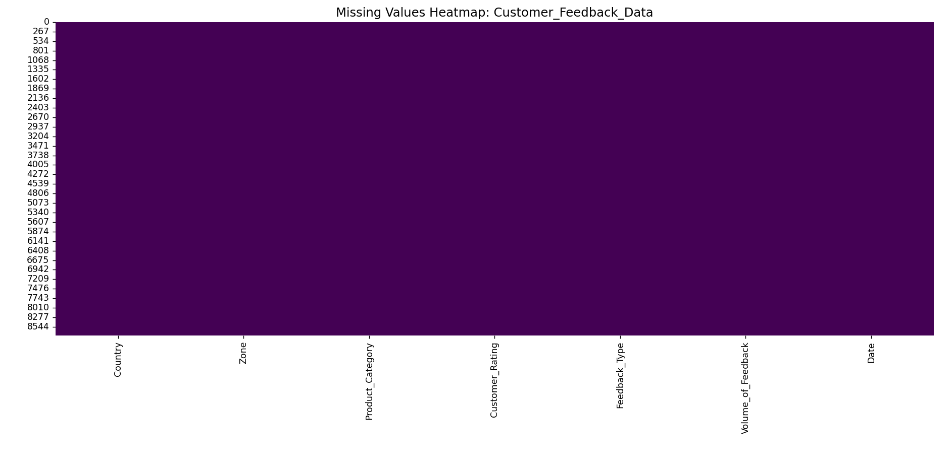

Slide 8
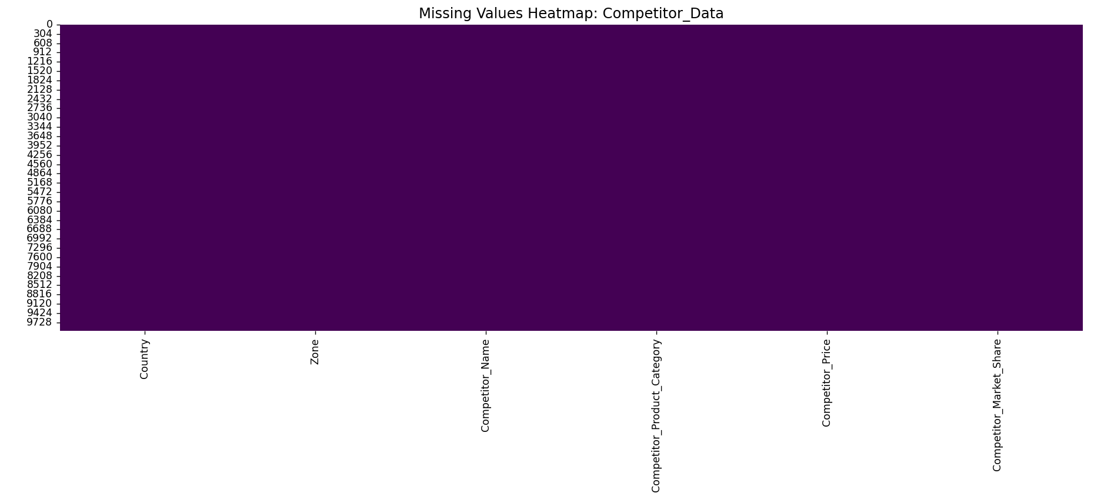

Slide 9
Removing Duplicate Data:-
Duplicate data occurs when the same row is repeated in the dataset.
For example:
1)A sale recorded twice will double the revenue, creating false results.
2)Duplicates can lead to overestimated trends and incorrect insights.
.

Slide 10
Implementation:-
Checked each dataset for duplicate rows.
Removed rows where all the values were the same as another row.
How Does the Data Look Now?
The dataset is free of duplicates, ensuring accuracy.
Each row now represents unique information.

Slide 11
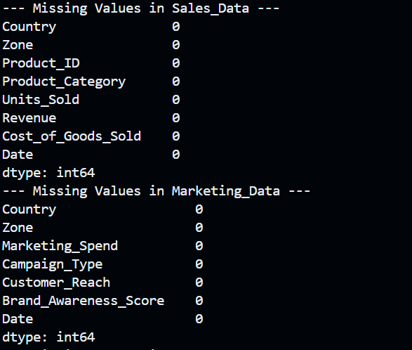

Slide 12
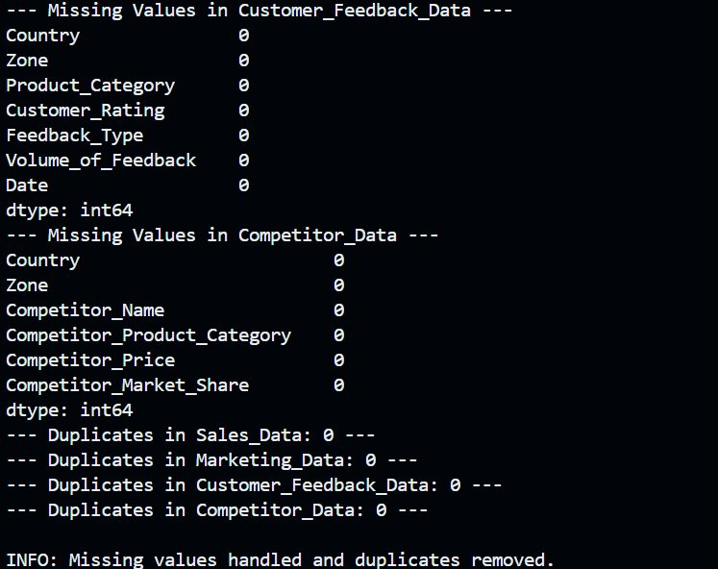

Slide 13
Standardizing Inconsistent Data
When data isn’t in the same format, it could cause confusion and errors during data analysis.
For example:
Dates written as 01/01/2024 in one row and 2024-01-01 in another mean the same thing but are inconsistent.
Country names like USA, United States, and US refer to the same country but are treated differently.

Slide 14
Implementation:-
Date format was Standardized to YYYY-MM-DD across all datasets. Example: 01/01/2024 and 2024/01/01 were converted to 2024-01-01.
Made country names uniform using a mapping table:
USA, US, and United States → USA
England and UK → United Kingdom.
Now All dates are consistent, making it easy to merge datasets.
Countries are labeled uniformly, avoiding mismatches.

Slide 15
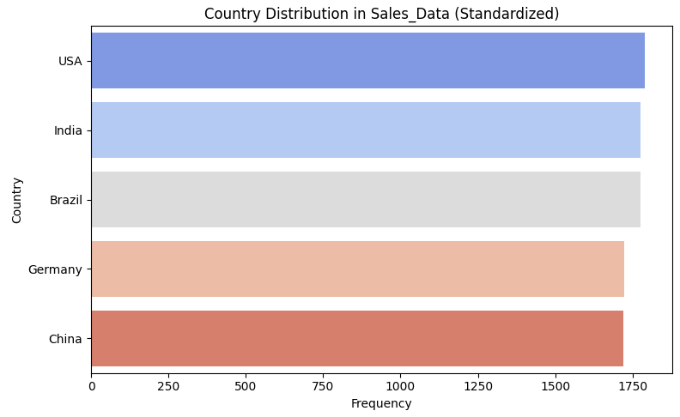

Slide 16
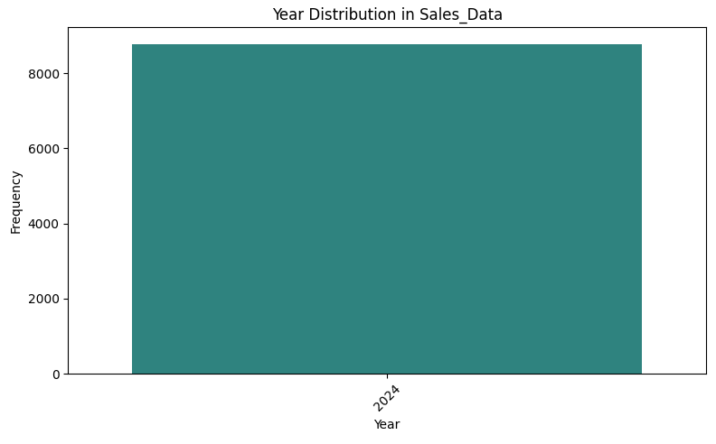

Slide 17
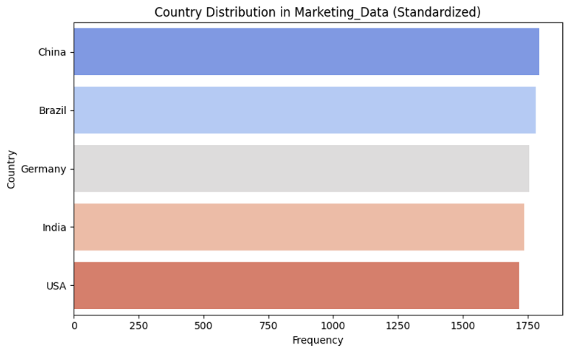

Slide 18


Slide 19
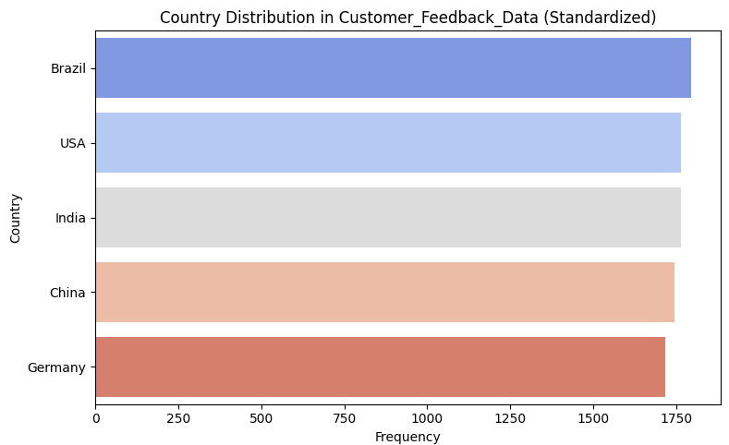

Slide 20
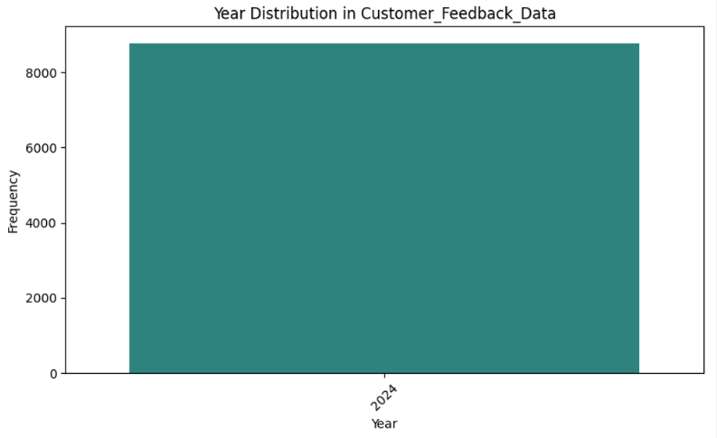

Slide 21
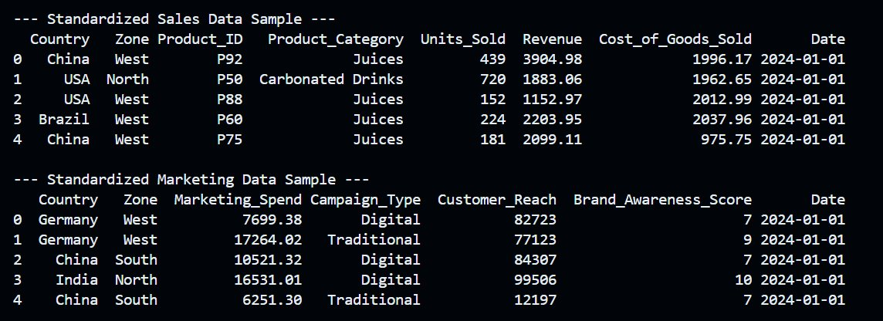

Slide 22
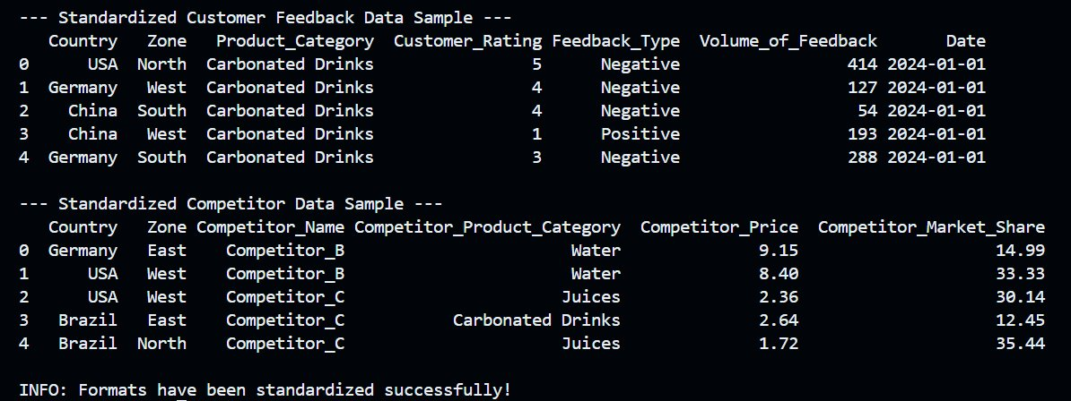

Slide 23
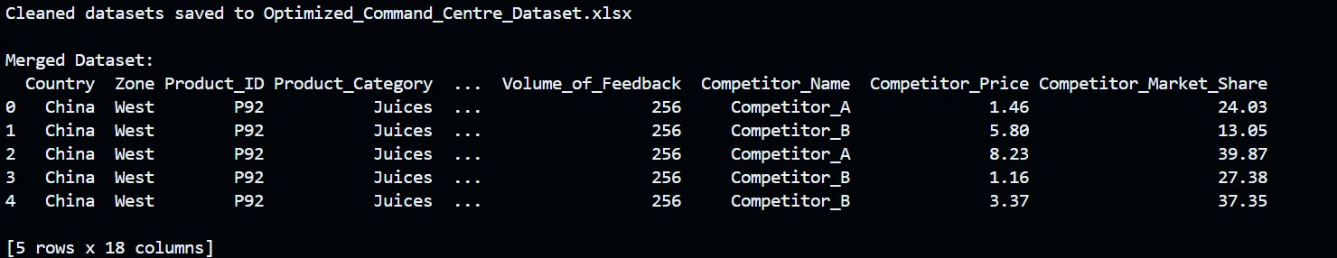

Slide 24
Merging Datasets:-
Merging is Combining Information from Multiple Sources
Why Is Merging Important?
Different datasets often hold pieces of the same attributes. Merging allows us to combine these pieces for a comprehensive view.
For example:
Sales data shows revenue and costs.
Marketing data explains spend and brand awareness.
Customer feedback data highlights ratings and feedback volume.
Competitor data adds context with market share and pricing.
.

Slide 25
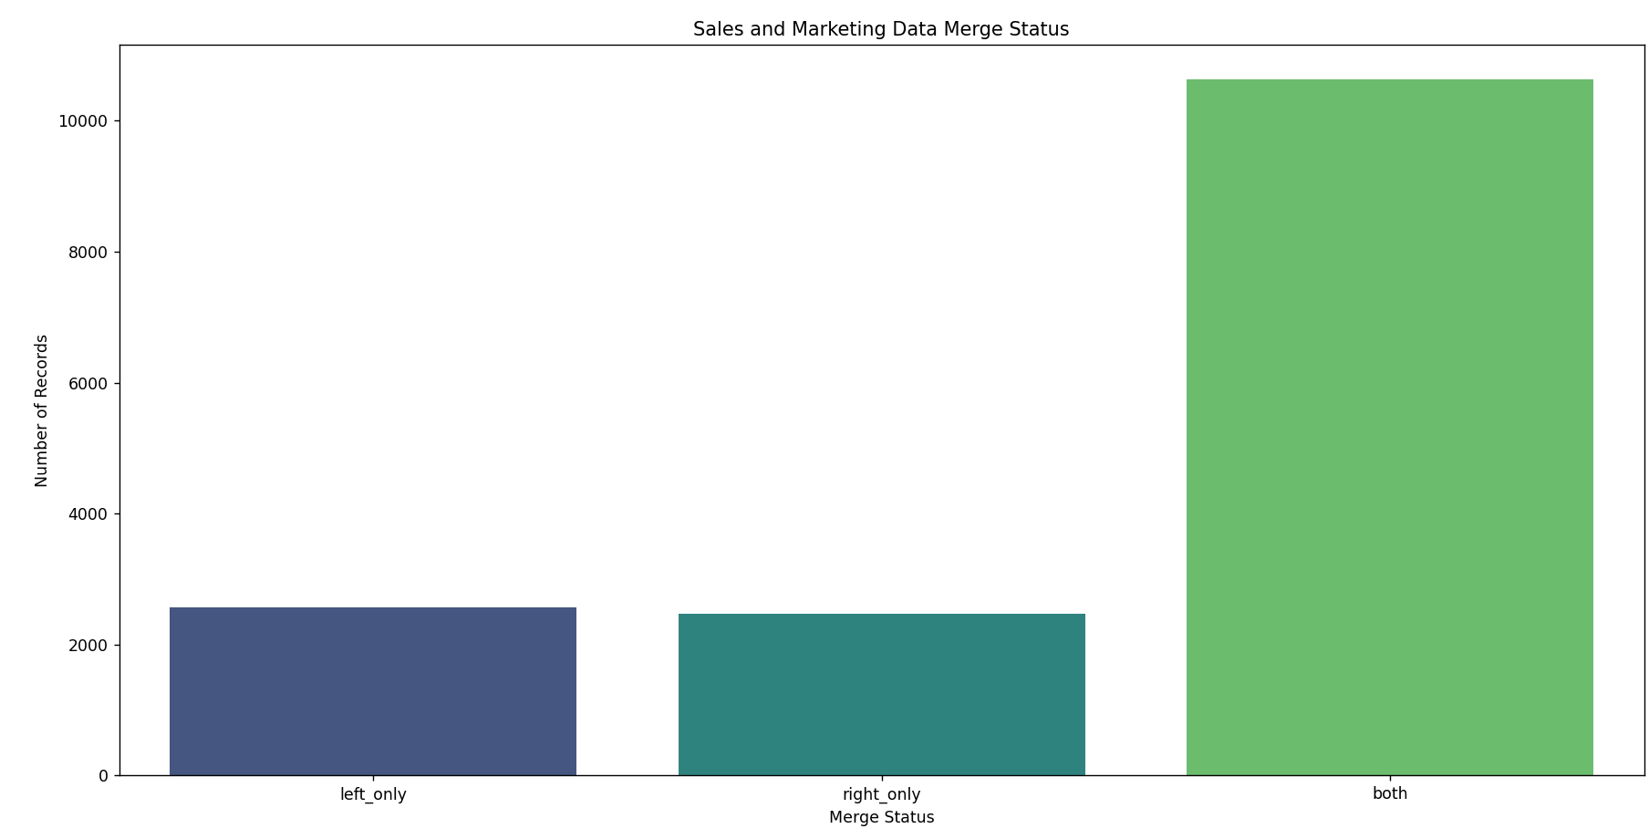

Slide 26
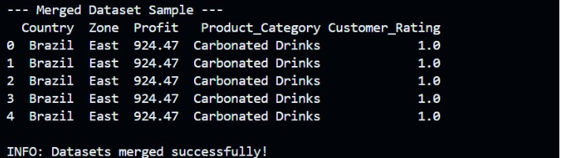
.

Slide 27
Why Is Merging necessary?
Merging brings together data from different sources to create a complete picture for analysis.
Each dataset holds unique insights:
Sales Data tells us about revenue and costs.
Marketing Data explains spending and brand awareness.
Customer Feedback Data highlights customer satisfaction and feedback trends.
Competitor Data shows pricing and market share.

Slide 28
How Did We Merge the Datasets?
Identified Common Keys:
We linked the datasets using Country, Zone, Date, and Product_Category.
Performed an Outer Join:
This ensured we captured all data, even if some rows were missing from one dataset.
It combines all relevant information in a single view, making analysis easier and more efficient.
By linking sales, marketing, feedback, and competitor data: We can identify patterns, correlations, and trends across regions and products.

Slide 29
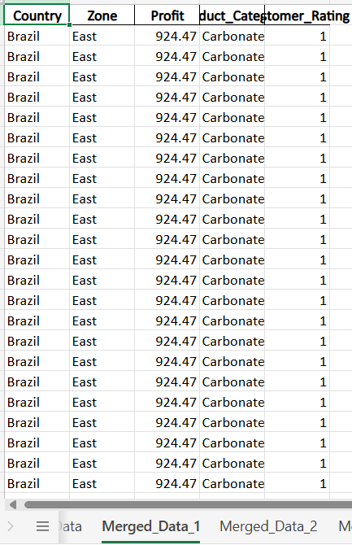

Slide 30
Data preparation transforms raw, messy data into a robust foundation for analysis, ensuring every decision is backed by reliable information. It eliminates errors, standardizes formats, and integrates diverse datasets into a cohesive whole. This process not only enhances the accuracy of insights but also saves time and effort during the analytical phase. With clean, organized data, we can uncover trends, patterns, and opportunities that drive meaningful business outcomes.

Slide 31
Profitability Analysis:-
Profitability analysis in our dataset involves assessing financial performance by calculating the profit for each zone and product category. Using the formula Profit = Revenue - Cost_of_Goods_Sold, we evaluate how effectively different regions and product types contribute to overall profitability. By grouping the data by Zone and Product_Category, we identify the most and least profitable areas and products. This allows us to pinpoint high-performing zones and categories, such as those generating maximum profit, for further investment and scaling. Similarly, low-performing zones or products are flagged for optimization or review. This analysis offers actionable insights to improve resource allocation, adjust marketing efforts, and refine pricing strategies to maximize returns. It serves as a foundation for strategic decision-making and business growth.

Slide 32
Steps to Determine the Most and Least Profitable Zones and Product Categories
1)Calculate Profit:
Formula:
Profit = Revenue - Cost_of_Goods_Sold
This calculation was applied to every row in the dataset to determine the profitability for each product in each zone.
2)Group Data by Zone and Product Category:
Data was grouped based on:
Zone: Represents geographical areas (e.g., North, South, East, West).
Product_Category: Represents product types (e.g., Juices, Water, Carbonated Drinks).
Total profit was aggregated for each combination of zone and product category.

Slide 33
3)Identify the Most Profitable Zones and Categories:
Zones and product categories with the highest total profits were flagged as high-performing.
Example:
Most Profitable Zone: West Zone
Most Profitable Product Category: Juices
Identify the Least Profitable Zones and Categories:
4)Zones and product categories with the lowest or negative profits were flagged as underperforming.
Example:
Least Profitable Zone: North Zone
Least Profitable Product Category: Water

Slide 34
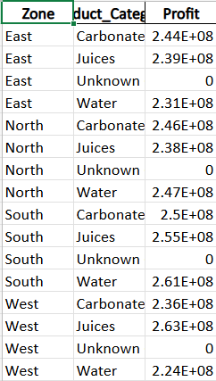

Slide 35
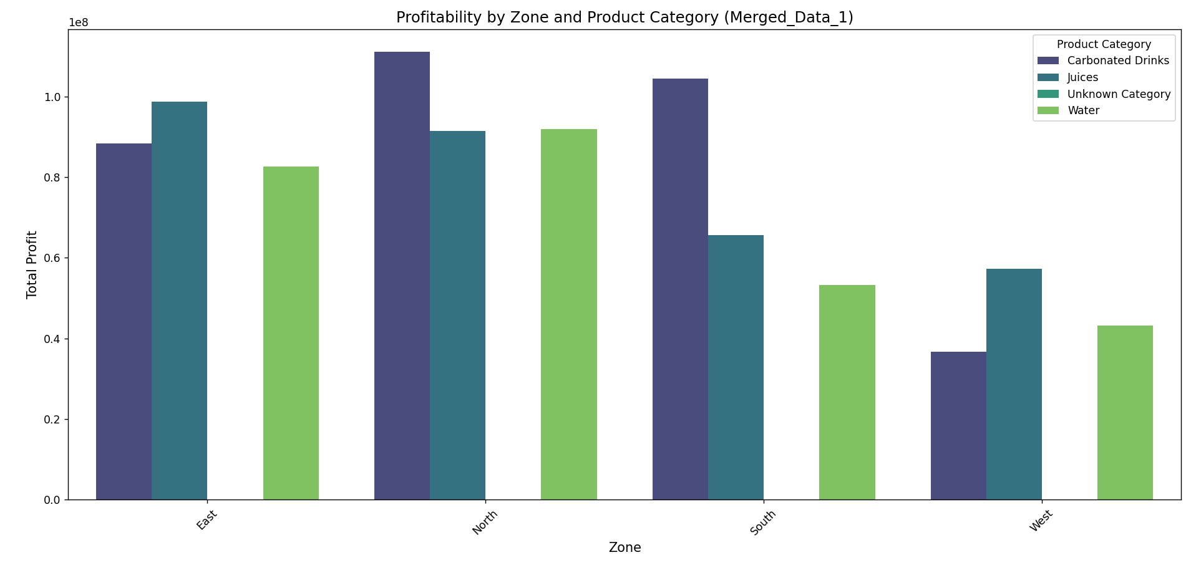

Slide 36
Brand Popularity Analysis
Brand Popularity Analysis focuses on understanding the factors that influence how well a brand is perceived by its customers. In our work, we analyzed three key metrics: Brand Awareness Score, Customer Rating, and Volume of Feedback. These metrics were used to measure customer familiarity, satisfaction, and engagement with the brand. By calculating correlations between these factors, we identified how closely they are interlinked. For instance, higher customer ratings often align with greater brand awareness and increased feedback volume, highlighting the effectiveness of marketing and customer engagement efforts. However, weaker correlations in certain zones or categories revealed areas where brand recognition strategies are not translating into customer satisfaction. This analysis provides actionable insights to improve brand perception and enhance customer loyalty in underperforming regions. The results are visualized using a heatmap, making it easier to interpret relationships between the metrics.

Slide 37
Analysis Process:
Data Selection:
Focused on three key metrics:
Brand Awareness Score: Reflects customer familiarity with the brand.
Customer Rating: Indicates satisfaction and perception of quality.
Volume of Feedback: Highlights customer engagement and response.
Correlation Analysis:
Measured the strength and direction of relationships between the selected metrics.
Visualized the correlation matrix as a heatmap for easier interpretation.

Slide 38
Insights Derived:
Positive Correlations:
Higher Brand Awareness Scores tend to align with higher Customer Ratings, indicating effective brand recognition strategies.
Increased Feedback Volume correlates positively with Customer Rating, suggesting engaged customers are likely to rate better.
Weak or Negative Correlations:
Highlight areas where awareness efforts might not be translating into positive feedback or ratings.
Visualization:
A correlation heatmap was generated to display the relationships between metrics.
Strength of correlation represented by color intensity:
Dark Red/Blue: Strong relationships.
Light Colors: Weak or no relationships.

Slide 39
Insights Derived:
Positive Correlations:
Higher Brand Awareness Scores tend to align with higher Customer Ratings, indicating effective brand recognition strategies.
Increased Feedback Volume correlates positively with Customer Rating, suggesting engaged customers are likely to rate better.
Weak or Negative Correlations:
Highlight areas where awareness efforts might not be translating into positive feedback or ratings.
Visualization:
A correlation heatmap was generated to display the relationships between metrics.
Strength of correlation represented by color intensity:
Dark Red/Blue: Strong relationships.
Light Colors: Weak or no relationships.

Slide 40


Slide 41
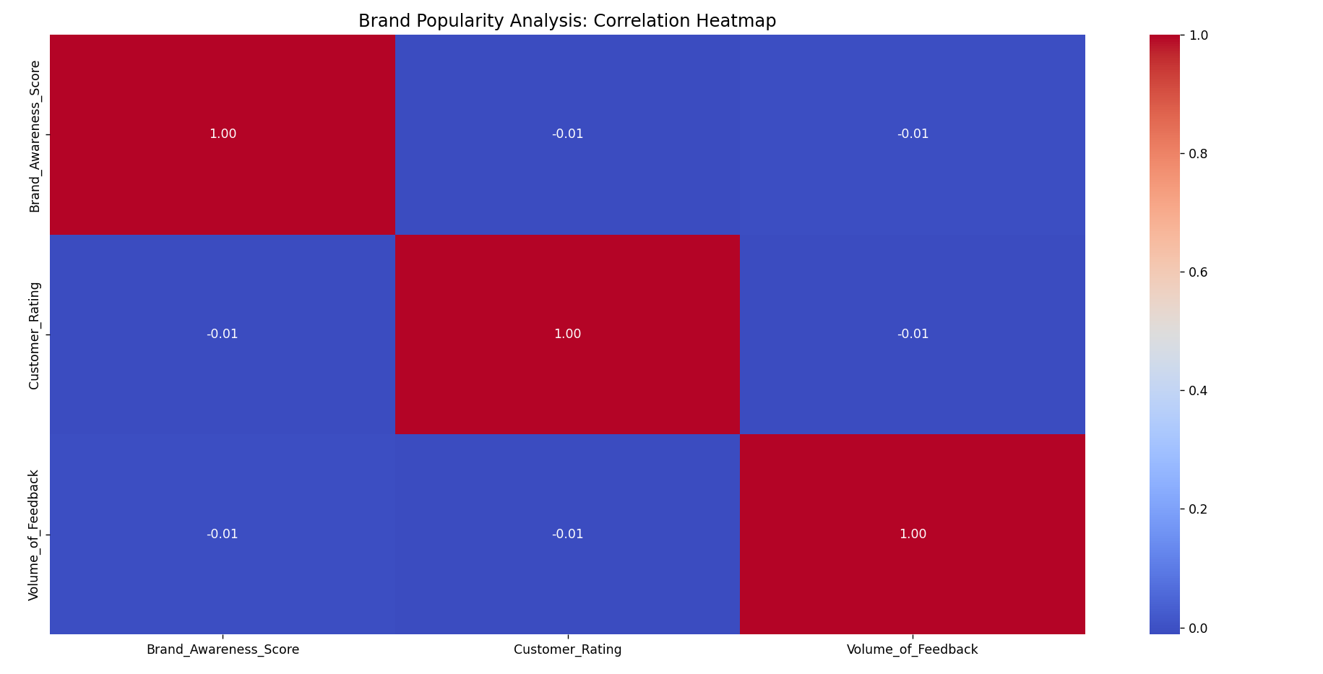

Slide 42
Competitive Positioning Analysis involves evaluating how competitors' pricing strategies influence their market share across different product categories. Based on the scatterplot, we identified trends in Carbonated Drinks, Juices, and Water, highlighting competitors' strengths and weaknesses. The analysis helps uncover opportunities to align pricing with market demands and outperform competitors. This approach supports informed pricing strategies for maximizing profitability and market share.

Slide 43
1. Pricing vs. Market Share Analysis
Objective: To assess the relationship between competitors' pricing strategies and their market share across different product categories.
The scatterplot highlights the price points of competitors and their corresponding market share percentages for Water, Juices, and Carbonated Drinks.
Competitors with higher prices tend to have a lower market share, indicating price sensitivity in certain zones or product categories.
Water appears to be priced competitively, but there is room for differentiation in Juices and Carbonated Drinks.

Slide 44
2. Key Observations
Competitor_A dominates the Carbonated Drinks market with moderate pricing and higher market share.
Competitor_B seems to have a lower market share in all categories, potentially due to higher pricing.
Competitor_C has a competitive price in Water but struggles to capture market share compared to Competitor_A.
3. Suggested Pricing Strategy
Align pricing strategies to optimize market share in zones where competitors dominate.
Experiment with value-based pricing for Carbonated Drinks, leveraging high demand and lower price sensitivity.
Introduce promotional campaigns for Juices to improve competitiveness without significant price reductions.
Focus on differentiation strategies in Water, such as sustainability or quality-based branding, to command a premium price.

Slide 45
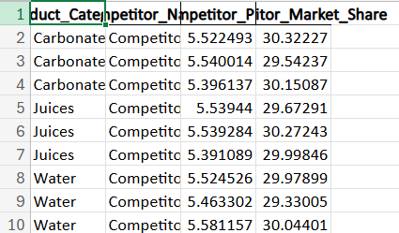

Slide 46
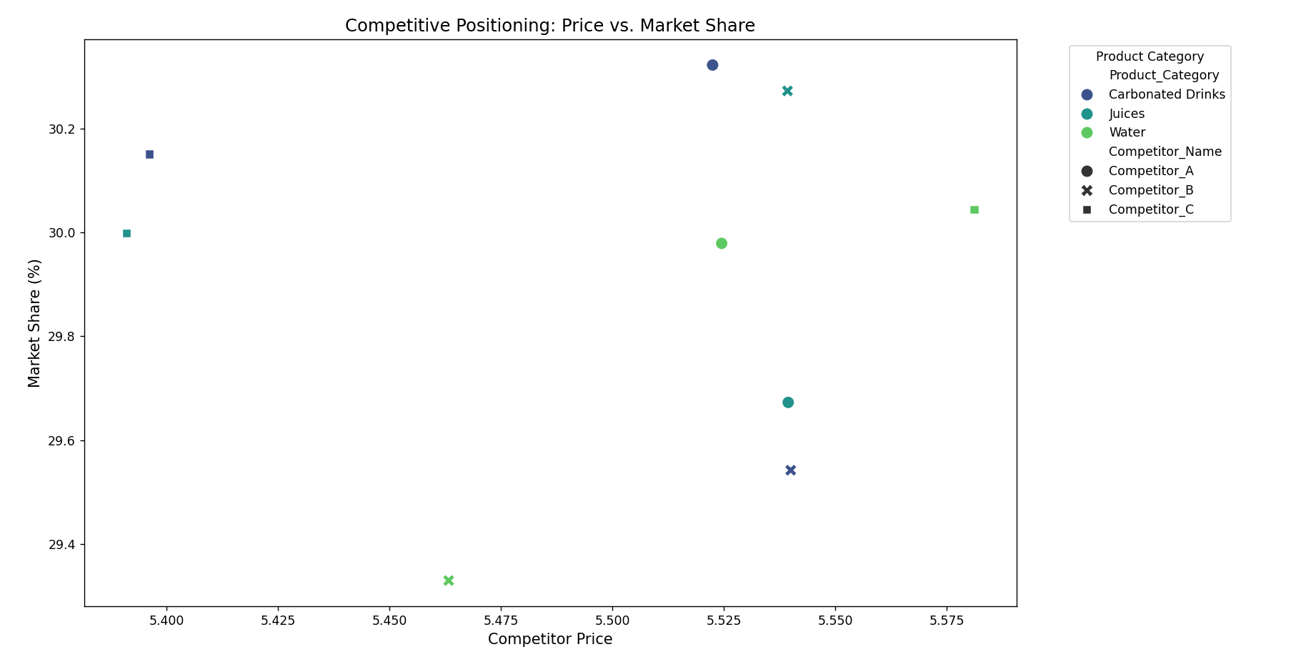

Slide 47
Recommendations are derived based on the insights from profitability analysis, brand popularity analysis, and competitive positioning. These actions aim to enhance profitability, strengthen the brand's presence, and align the company’s competitive strategies to achieve business goals effectively.
Key points for recommendations:-
Profitability Insights:
Focus on the most profitable zones and product categories to maximize returns.
Revisit the least profitable zones and categories to identify inefficiencies and strategize improvements.

Slide 48
Brand Popularity Insights:
Increase brand awareness in underperforming regions by investing in targeted marketing campaigns.
Encourage customer feedback to boost engagement and identify areas for product/service enhancement.
Address low customer ratings by improving product quality and customer support.

Slide 49
Competitive Positioning Insights:
Align pricing with top competitors to remain competitive in the market.
Strengthen market share in product categories where competitors are currently outperforming.
Explore innovative pricing strategies for price-sensitive zones to attract new customers.

Slide 50
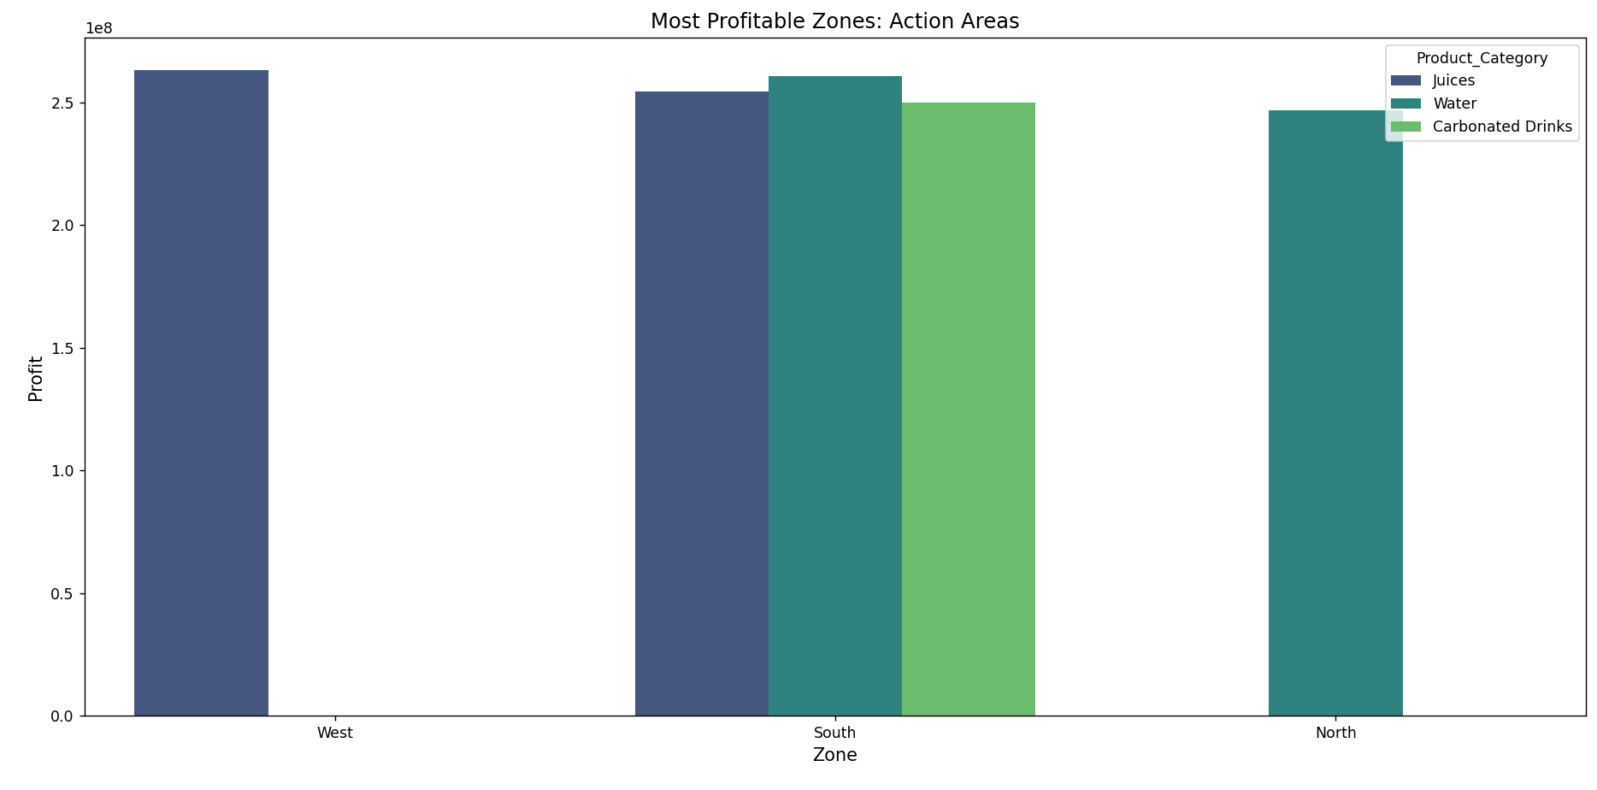

Slide 51
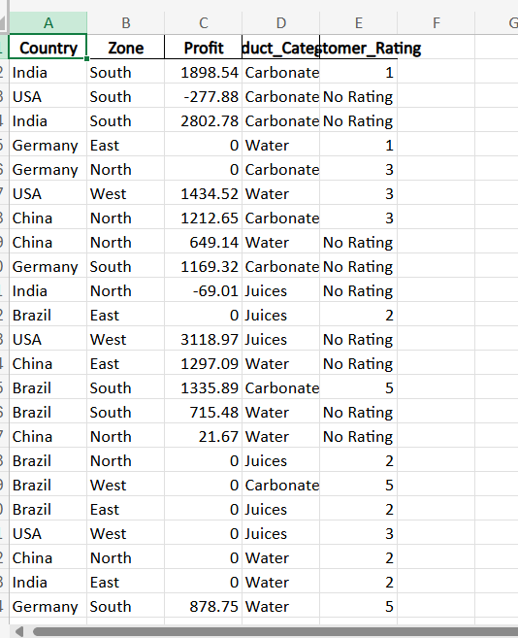

Slide 52
Thank you
Made by – Viral upadhyay

